Slide 1


TweetSentiment - Social Media Insights
Submitted By : Debabrata Mishra

Slide 2




Introduction
Analyzing public sentiment on Twitter
Tracking sentiment trends over time
Leveraging natural language processing techniques to understand the overall mood and opinions expressed by Twitter users on various topics
Monitoring how public sentiment evolves on Twitter, capturing changes in mood and opinions on current events and issues
Uncovering influential topics and discussions
Identifying positive, negative, and neutral sentiments
Identifying the key topics, keywords, and themes that are driving significant sentiment on Twitter
Classifying tweets as expressing positive, negative, or neutral sentiment
This introductory slide provides an overview of the sentiment analysis approach that will be explored in the 'TweetSentiment' presentation, highlighting the insights that can be gained from examining public sentiment on Twitter.

Slide 3
Problem Statement
Define the Problem
Identify the key objectives of understanding public sentiment and how it can inform data-driven decision-making.
Explore Twitter Data
Gather and analyze Twitter data to understand the current public sentiment on relevant topics or issues.
Develop Sentiment Analysis Model
Design and implement a sentiment analysis model that can accurately classify tweets as positive, negative, or neutral.
Interpret Insights
Analyze the sentiment insights to identify patterns, trends, and key drivers of public opinion that can inform data-driven decisions.

Slide 4



Dataset Information
Twitter Tweets
Sentiment Labels
Metadata
The dataset consists of tweets collected from the Kaggle Dataset.
Each tweet is labeled with one of the sentiment categories: Positive, Negative, Neutral, or Irrelevant.
The dataset includes metadata such as tweet ID, Sentiment, Entities, and Tweet Context,
The dataset provides a comprehensive set of tweets with sentiment labels and metadata, enabling in-depth analysis of user sentiment on the Twitter platform.
Contd….

Slide 5
Dataset Information
Sentiment
Sentiment Classification
The process of categorizing the sentiment expressed in a tweet into predefined categories such as Positive, Negative, Neutral, or Irrelevant.
Positive Sentiment
Tweets expressing a favorable or approving attitude towards a topic or subject.
Negative Sentiment
Tweets expressing an unfavorable or disapproving attitude towards a topic or subject.
Neutral Sentiment
Tweets that do not express a clear positive or negative sentiment, but rather a neutral or objective viewpoint.
Irrelevant Sentiment
Tweets that do not contain any meaningful sentiment towards the topic of interest and are considered irrelevant for the analysis.

Slide 6
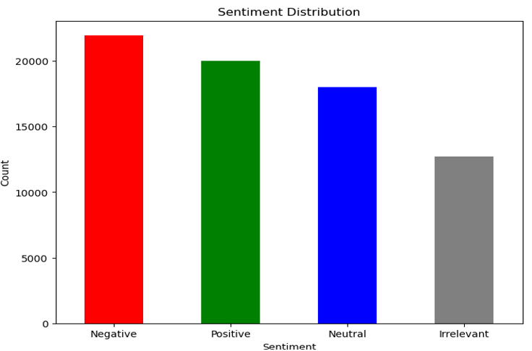
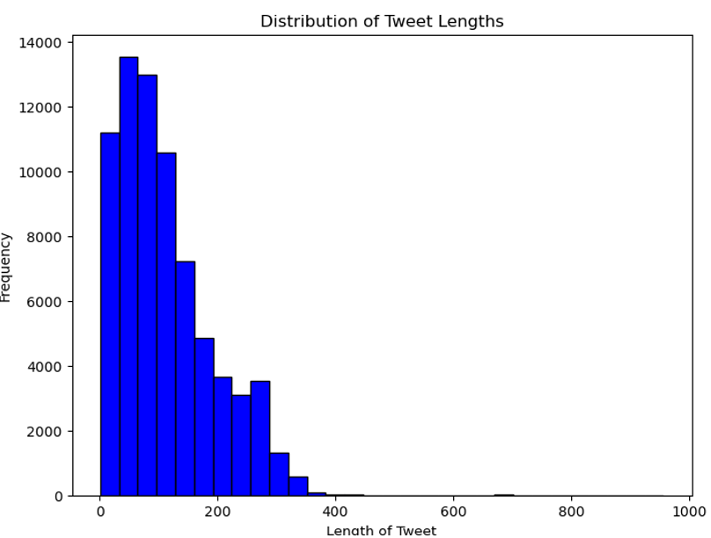
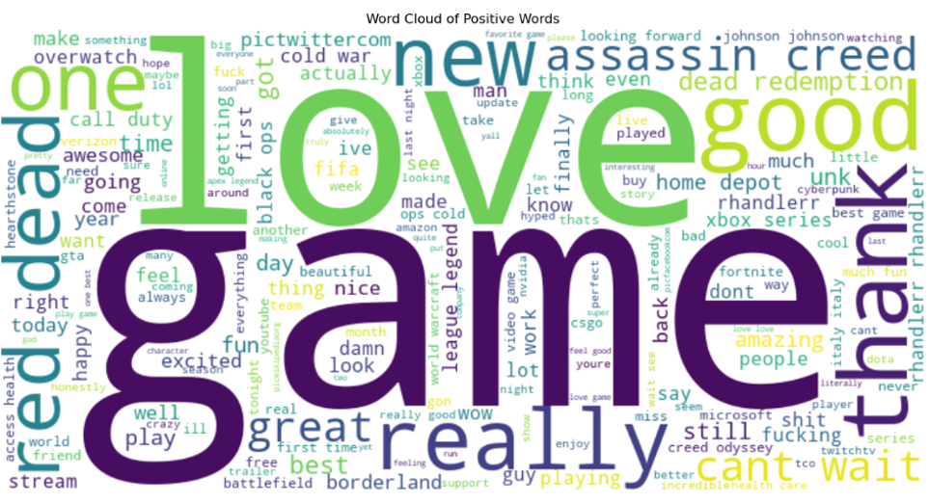
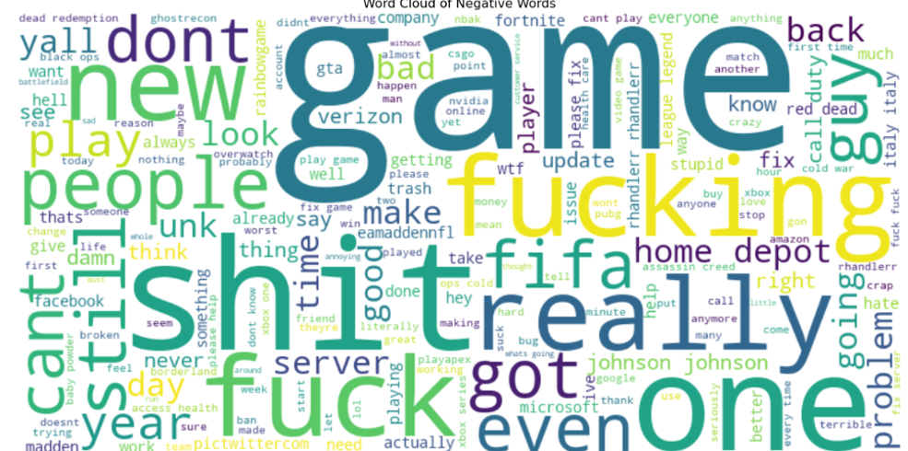
Exploratory Data Analysis (EDA)
SENTIMENT DISTRIBUTION
TWEET LENGTH HISTOGRAM
WORD CLOUD OF POSITVE TERMS
WORD CLOUD OF NEGATIVE TERMS
A histogram showing the distribution of positive, negative, and neutral sentiment scores across the Twitter data.
A histogram depicting the distribution of tweet lengths, provides insights into the typical length of tweets in the dataset.
A visually appealing positive word cloud highlighting the most frequently used terms in the Twitter data, allowing for the identification of popular topics and themes.
A visually appealing negative word cloud highlighting the most frequently used terms in the Twitter data, allowing for the identification of popular topics and themes.

Slide 7



Data Processing
Data Cleaning
Feature Engineering
Text Preprocessing
Train-Test Split
Removed irrelevant or duplicate tweets, handle missing values, and correct any typographical errors or inconsistencies in the data.
Extract relevant features from the tweet text, such as the presence of URLs, hashtags, mentions, and sentiment-related words, to prepare the data for analysis.
Performed text preprocessing techniques such as converting text to lowercase, removing stop words, handling punctuation, and applying stemming or lemmatization to standardize the text.
Dividing the dataset into training and testing sets to evaluate the model's performance and prevent overfitting.

Slide 8
Model Selection
Evaluate Model Performance
Identify Top-Performing Model
Validate Model Robustness
Assess the performance of each candidate model using relevant metrics such as accuracy, precision, recall, and F1-score.
Recommend the model with the highest overall performance as the top-performing model for deployment.
Ensure the selected model is robust and can handle a variety of input data and edge cases.
Analyze Feature Importance
Assess Deployment Feasibility
Investigate the feature importance to understand the key drivers of the model's predictions.
Evaluate the feasibility of deploying the selected model in the production environment, considering factors like computational resources and integration requirements.

Slide 9
Model Evaluation
Model
Accuracy

Slide 10




Conclusion
SUMMARY OF ANALYSIS
POTENTIAL CHALLENGES
Provided an overview of the sentiment analysis conducted on the Twitter data, including insights on the overall sentiment trends, key drivers of positive and negative sentiment, and implications for the business.
Highlighted potential challenges such as dealing with evolving Twitter data, addressing biases in the training data, and ensuring the model remains robust over time.
POTENTIAL OPPORTUNITIES
CHOSEN MODEL FOR DEPLOYMENT
Identified opportunities to enhance the sentiment analysis, such as incorporating additional data sources, leveraging natural language processing techniques, and automating the model deployment and monitoring processes.
Determined that the LinerarSVC classifier model provided the best performance in terms of accuracy, precision, and recall, and is recommended for deployment.
THE SENTIMENT ANALYSIS CONDUCTED ON THE TWITTER DATA PROVIDED VALUABLE INSIGHTS THAT CAN INFORM BUSINESS DECISIONS. THE LINEARSVC CLASSIFIER MODEL IS RECOMMENDED FOR DEPLOYMENT, BUT ONGOING MONITORING AND REFINEMENT WILL BE NECESSARY TO ADDRESS POTENTIAL CHALLENGES AND CAPITALIZE ON EMERGING OPPORTUNITIES.

Slide 11

Ethical Considerations
I prioritized user privacy by strictly following data privacy regulations. All personal identifiers were removed to ensure anonymization, and data access was restricted solely to authorized personnel, protecting user information and aligning with legal standards. Addressing potential biases in both the dataset and model was equally important. I applied methods to identify and reduce biases, ensuring the sentiment analysis results were fair and accurate. This included using a diverse dataset to prevent skewed representations and implementing fairness metrics to assess the model’s performance across various demographics. Additionally, the algorithm was continuously monitored and adjusted to address any detected biases, supporting an ethical and responsible approach to sentiment analysis.

Slide 12
